Slide 1
Australian Battery Recycling Initiative
Strategic Plan 2014 - 2017
April 2014

Slide 2
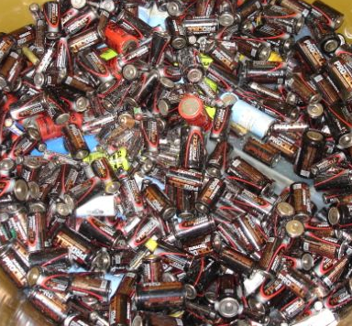
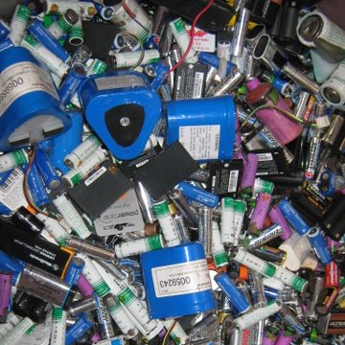
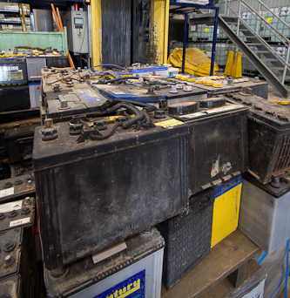
Vision
Our vision is simple:
Effective stewardship of all end of life batteries

Slide 3
Types of batteries covered
Handheld batteries (< 1kg)
Single use
Rechargeable
Alkaline manganese
Zinc carbon
Zinc air
Silver oxide
Manganese dioxide
Nickel cadmium
Nickel metal hydride
Lithium
Lead acid
Automotive SLI batteries
Rechargeable
Nickel cadmium
Nickel metal hydride
Lead acid
Lithium ion
Lithium polymer
Large and industrial batteries
Rechargeable
Lead acid
Source: Warnken (2010), Analysis of battery consumption, recycling and disposal in Australia, ABRI
Notes:
One of the challenges involved in this type of study is the diversity of product – by end market, size, chemistry etc.
For the purpose of the report we divide them into handheld (<1kg), automotive and large & industrial batteries. Automotive batteries have been separated from large & industrial batteries because this is a significant category in terms of battery flows.
Wherever possible consumption, stocks and arisings have also been broken down by chemistry.

Slide 4
Principles
ABRI’s strategic plan is based on two principles:
Product stewardship: the principle that everyone involved in the production, distribution, consumption and recovery of a product shares responsibility for managing its environmental and social impacts
The waste hierarchy: the principle that material recycling is the environmentally preferable option for end of life management, followed by energy recovery and safe disposal.
Material recycling
Energy recovery
Safe disposal

Slide 5
Mission
ABRI will achieve its vision by providing leadership in the following areas:
Promoting the diversion of batteries from landfill to recycling facilities.
Encouraging maximum resource recovery from end of life batteries to capture their commercial and environmental value.
Facilitating an expanded infrastructure for the collection and processing of end of life batteries.
Advocating and promoting best practice standards for the collection, storage, packaging, transport and processing of end of life batteries.
Working with stakeholders in industry, government and the community to achieve our objectives.

Slide 6
Strategic issues
Leadership
Awareness
Education
Legal framework
Infrastructure

Slide 7
Objectives
Leadership
Collect and disseminate accurate and credible information on the environmental impacts of batteries at end of life
Recognise and promote safe and environmentally responsible battery recycling
Develop affiliations with battery recycling organisations in Australia and overseas
Engage with stakeholders to achieve our objectives
Be the peak body for battery recycling in Australia and New Zealand

Slide 8
Objectives
Promote existing collection and recycling services for used batteries
Promote ABRI as the primary source of information on battery recycling
Raise awareness about ABRI amongst consumers, industry and government
Increase ABRI membership
Awareness

Slide 9
Objectives
Education
Develop resources on how batteries are recycled and the environmental and social benefits
Educate the recovery chain, including waste generators and local councils, on safe and environmentally responsible collection, storage, packaging, transport and processing
Provide information to all stakeholders on different battery technologies
Promote chain-of-custody responsibilities to battery consumers, collectors, transporters and recyclers
Advocate that large purchasers of batteries include take-back and recycling in battery procurement

Slide 10
Objectives
Support the development of a national stewardship scheme for handheld batteries under the Product Stewardship Act
Work with federal and state government agencies to achieve nationally consistent hazardous waste and dangerous goods regulations for used lead acid batteries
Work with waste generators and government regulators to reduce illegal activity, including unlicensed storage and transport and illegal exports of used lead acid batteries
Work with federal government agencies to achieve internationally consistent export, transport and packaging regulations for used batteries
In collaboration with international organisations, investigate options for improved chemistry labelling of handheld batteries
Legal framework

Slide 11
Objectives
Undertake research on best practice and legally compliant battery collection systems
Develop a sustainable funding model for handheld battery recycling
Work with government and industry stakeholders to improve collection programs for handheld batteries
Provide support for the BatteryBack program in partnership with Sustainability Victoria
Facilitate increased collection of automotive, large and industrial batteries in remote and regional areas
Work with stakeholders to ensure that there are pathways for handling new and emerging battery technologies including lithium
Infrastructure

Slide 12
for more information
Australian Battery Recycling Initiative Inc.
Dr Helen Lewis CEO
T: +61 2 4268 6629
M: +61 419 010 158
E: info@batteryrecycling.org.au
W: www.batteryrecycling.org.au

