Slide 1
AUSTRALIAN BATTERY RECYCLING INITIATIVE
Who we are and what we do

Slide 2
Our members

Slide 3
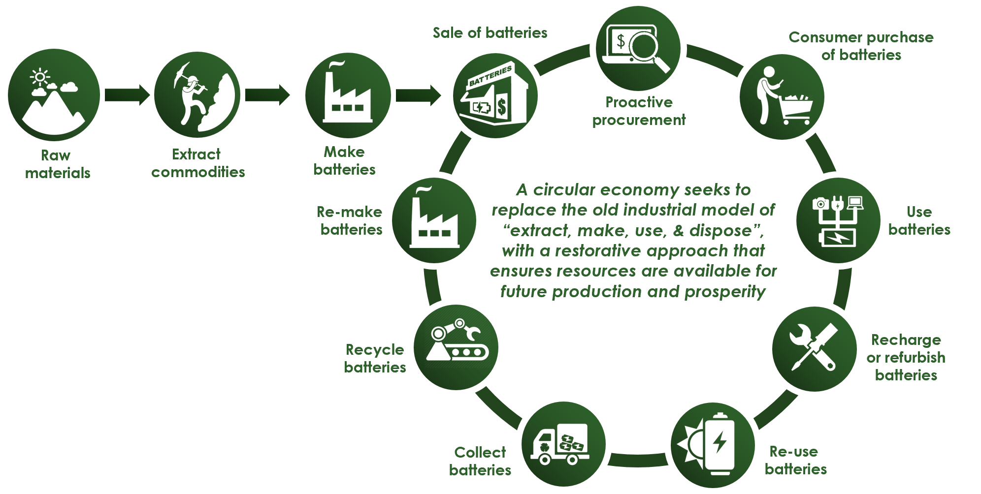
ABRI vision is to facilitate a circular economy
Providing research, advocacy, education, stakeholder engagement & leadership in the battery knowledge base
ABRI is the first point of call for information on battery stewardship & recycling

Slide 4
Batteries by the numbers
We recycle 90% of lead acid batteries
Lead acid batteries provide a stellar example of a circular economy
In 2012-13, an estimated 400 million
handheld batteries, weighing 17,500 tonnes, were sold into the Australian market
14,700 tonnes reached their end-of-life that year
We only recycled 2.7 % of them
(SRU, 2014)

Slide 5
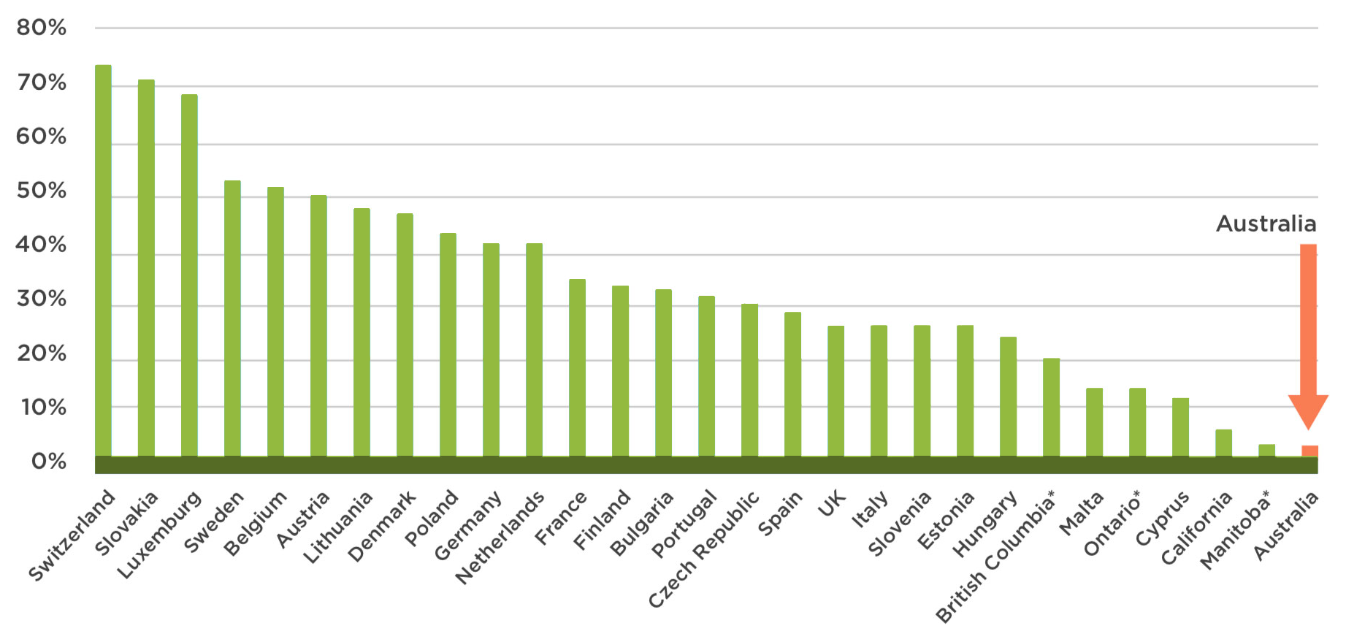
Collection rate in Australia is one of the lowest in the world
(Lewis, H, 2016)

Slide 6
BATTERIES ARE A RAPIDLY EXPANDING WASTE STREAM By 2036 we will be wasting 136,000 tonnes of handheld batteries annually
136,000 tonnes is about the weight of the opera house

Slide 7
ABRI and our members are leading the way
By creating sustainable battery stewardship solutions for all battery chemistries

Slide 8
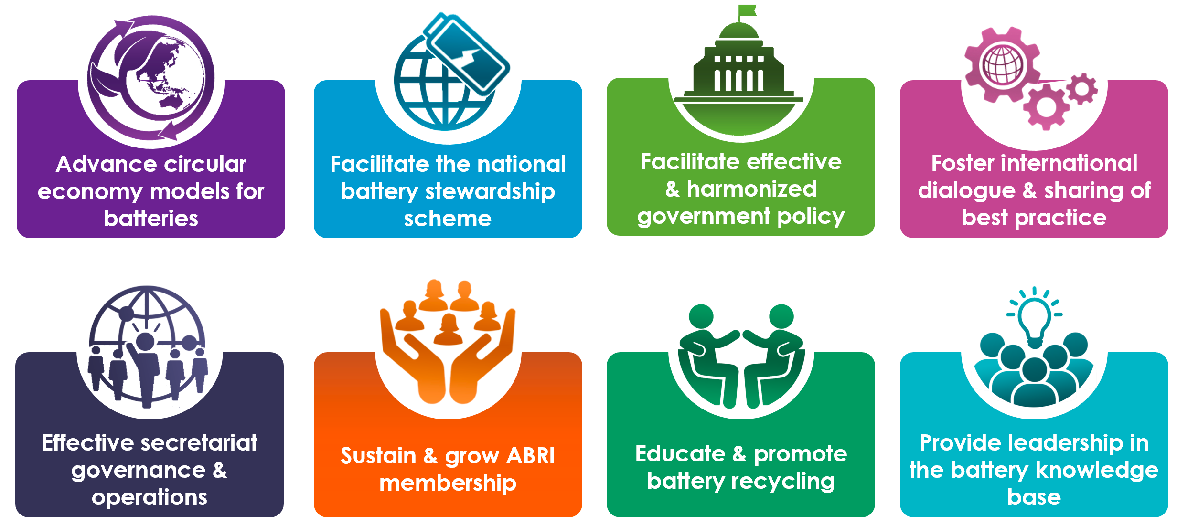
Our objectives

Slide 9
Leading the knowledge base

Slide 10
Educating industry, government and the wider community about battery recycling, best practice, stewardship and circular economy

Slide 11
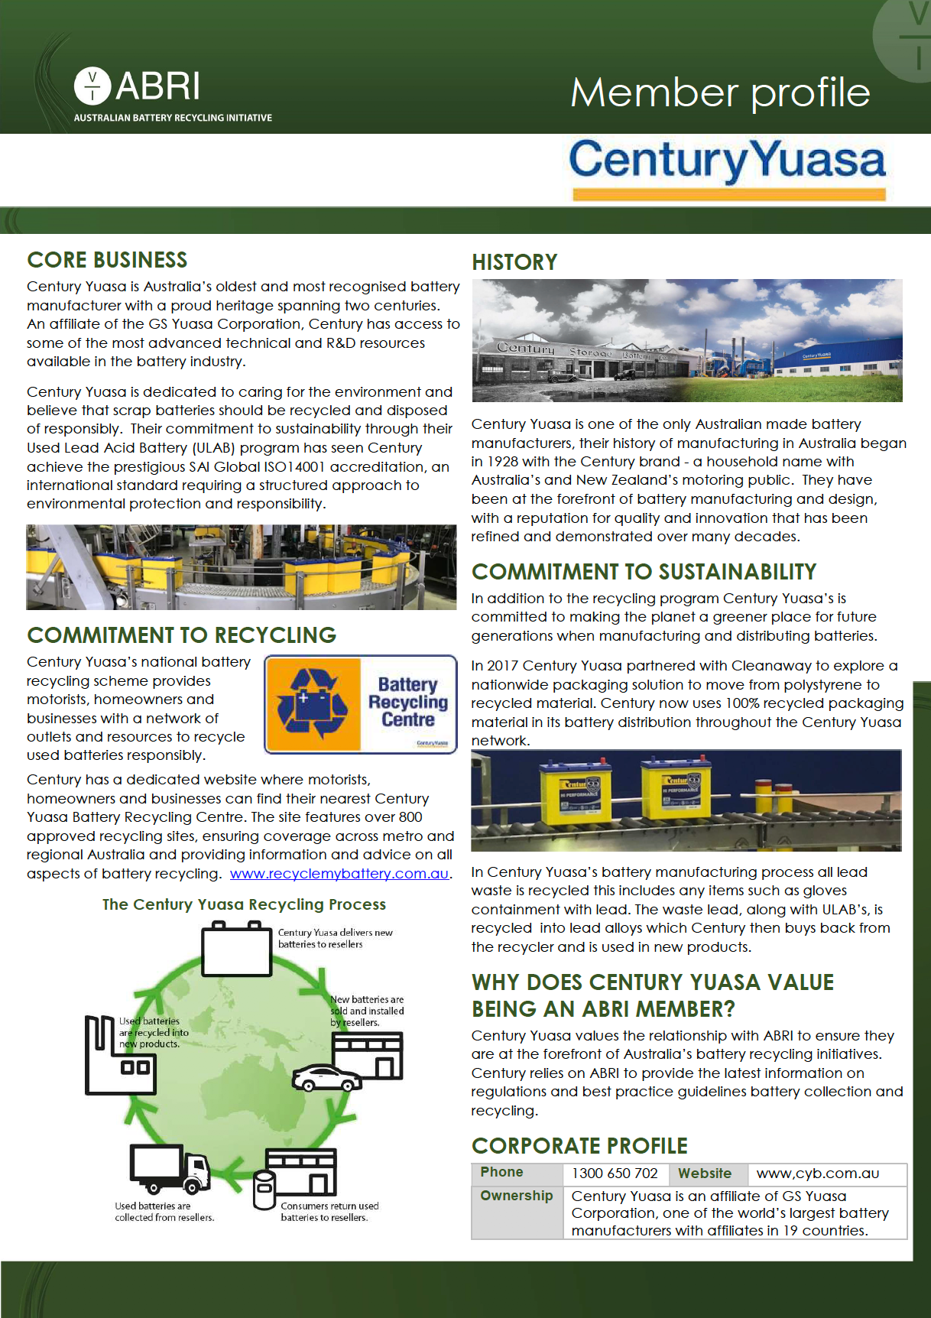
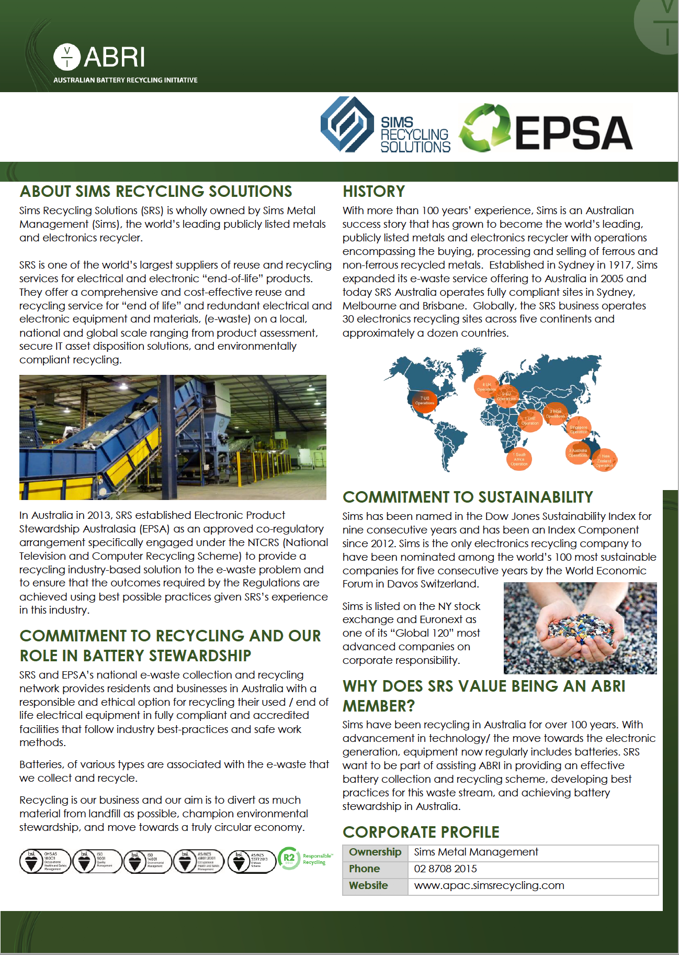
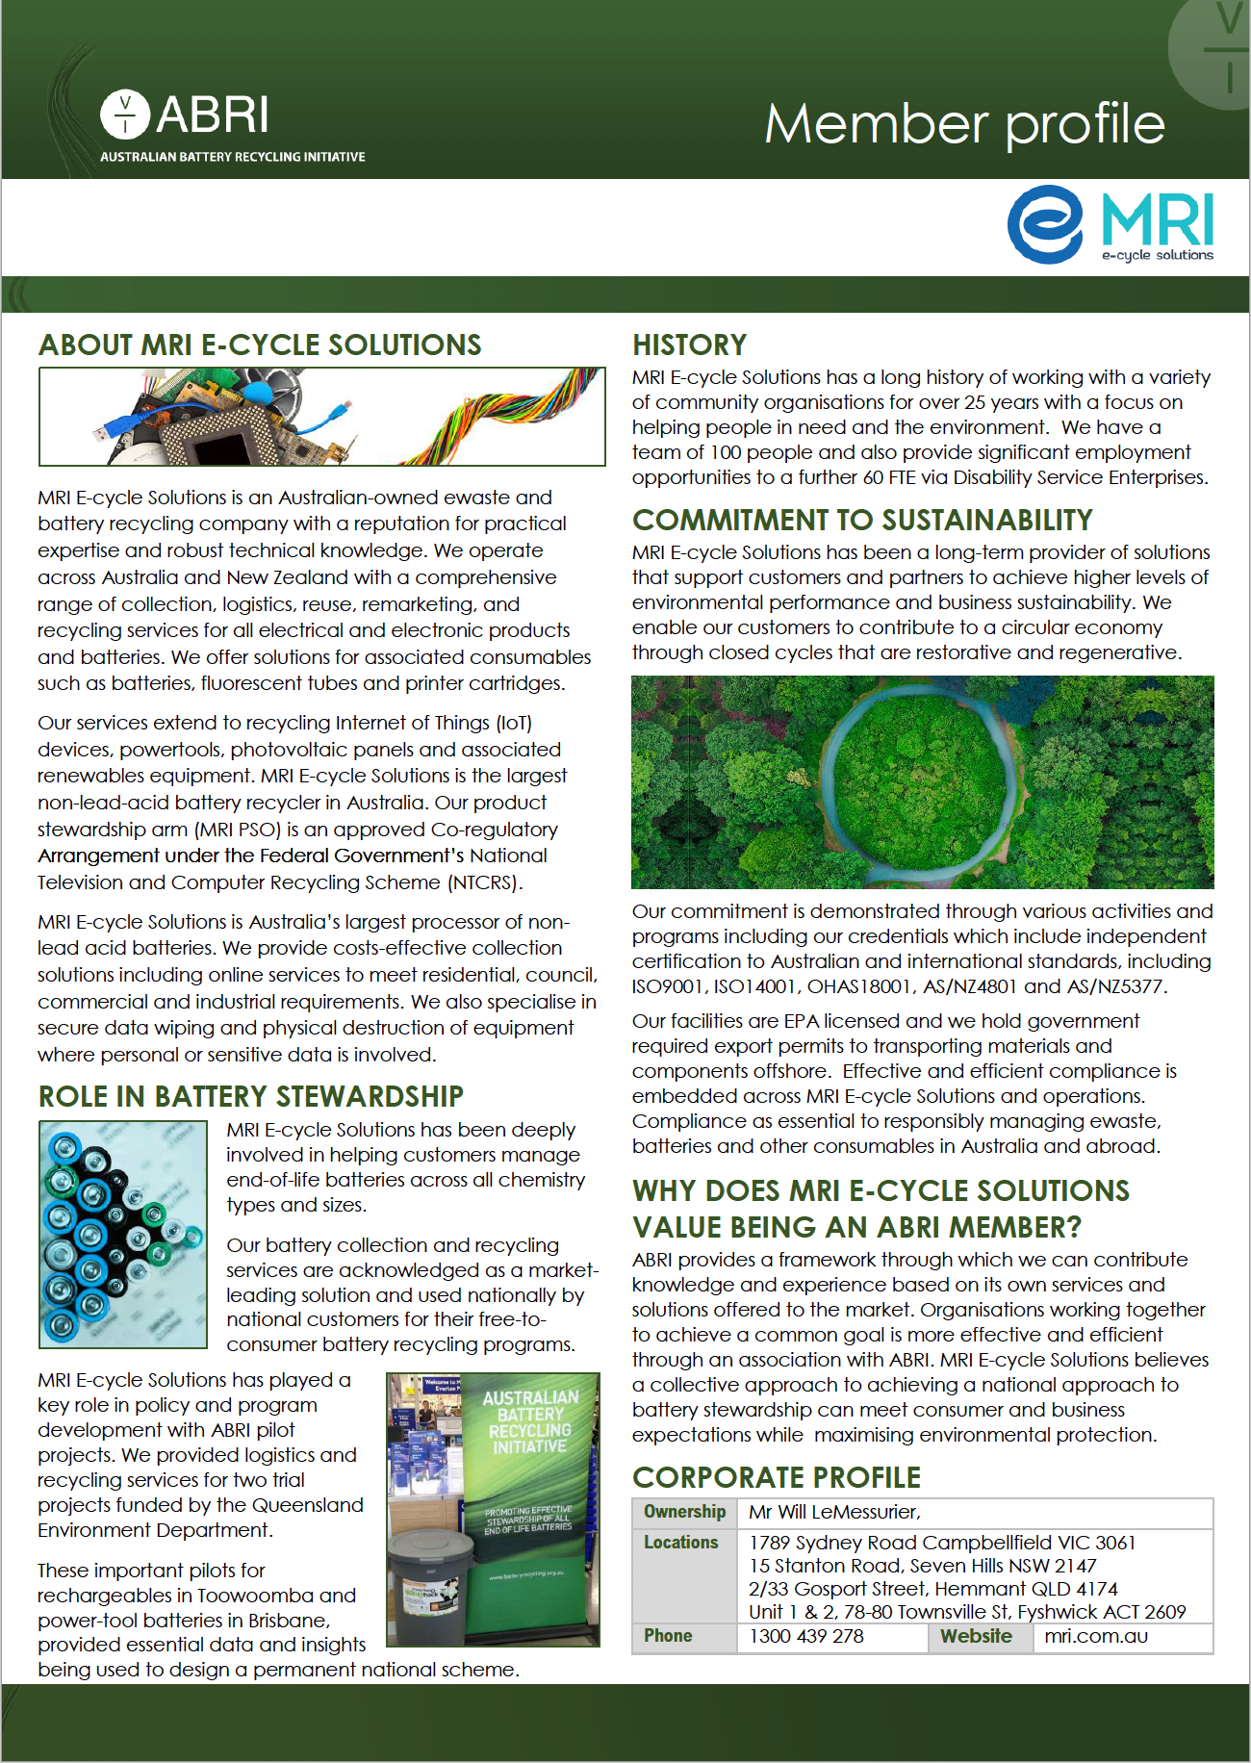
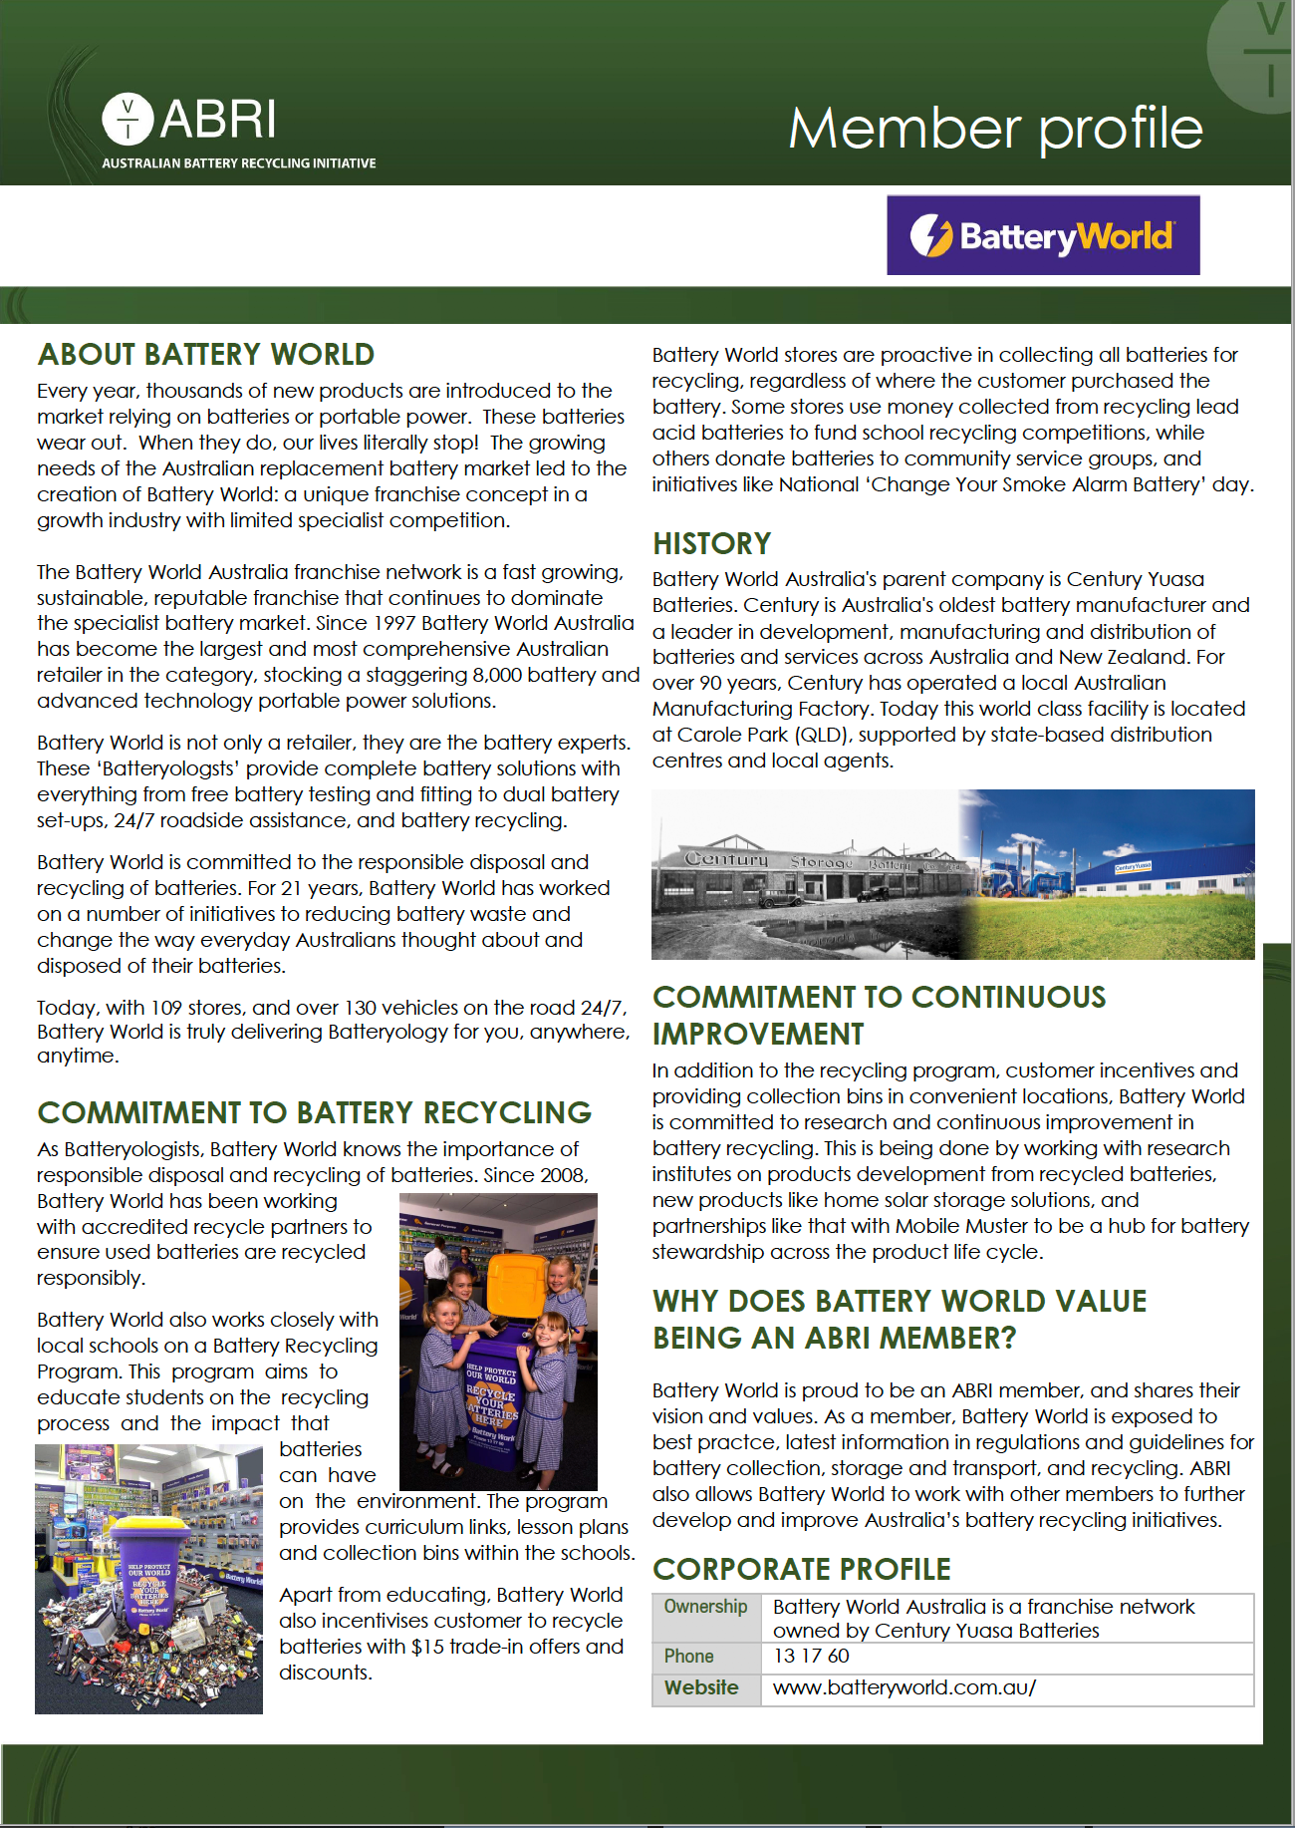
Showcasing member capabilities
Our value is in our membership
Members are invited to create Member Profiles
to showcase their expertise & services
Available for download at the ABRI website

Slide 12
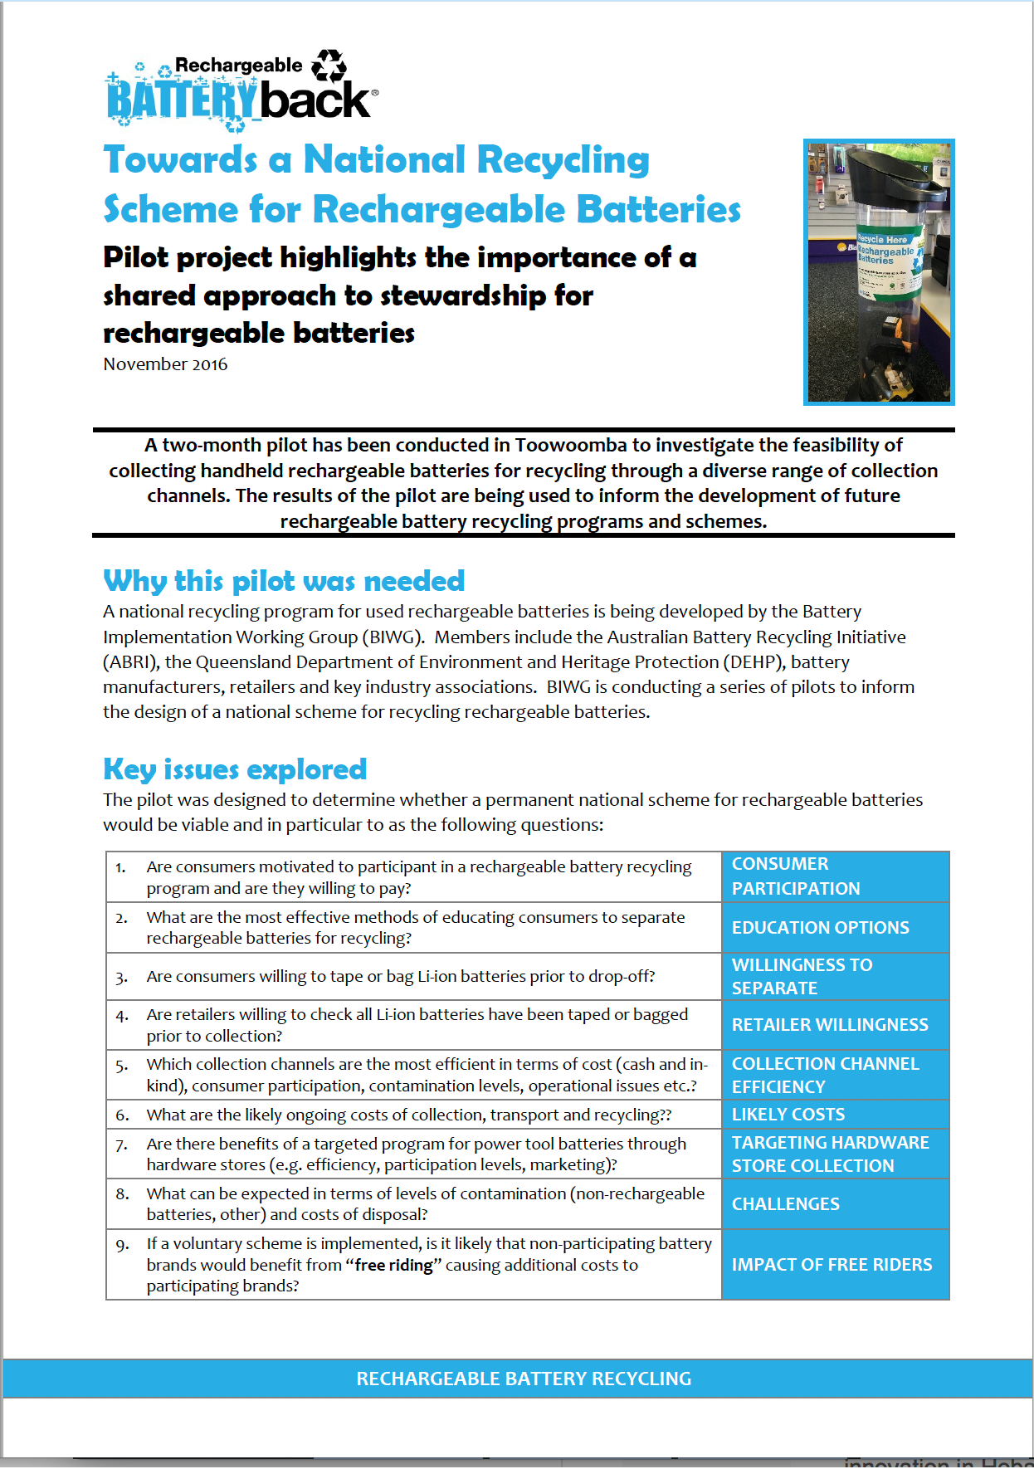
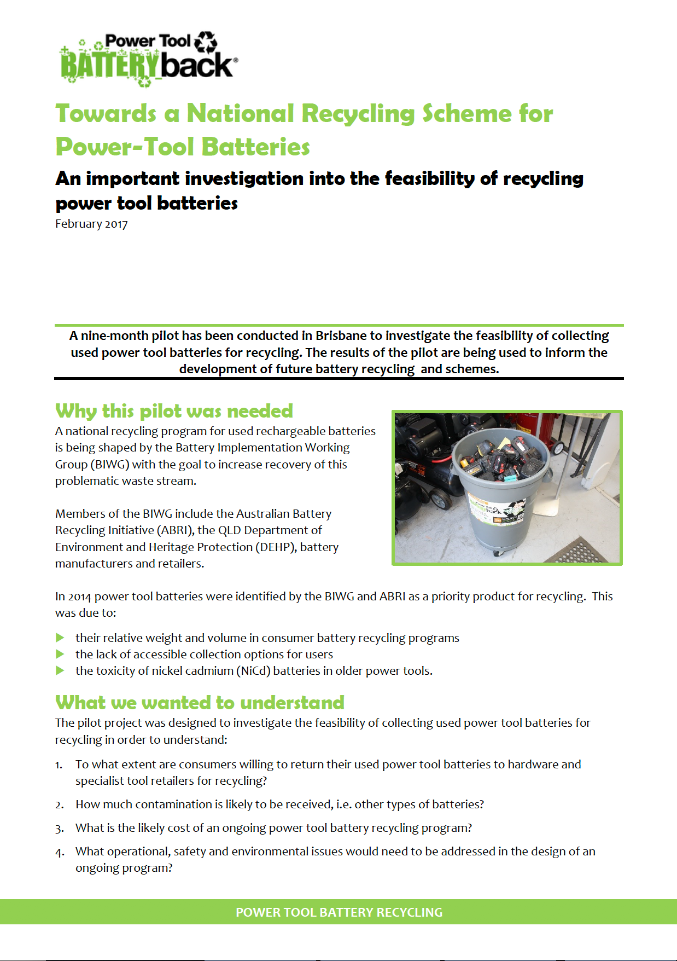
Support for battery stewardship
ABRI conducts trials and facilitates research to understand the market and the on the ground realities for increasing collection rates
ABRI plays an leadership role in the
Battery stewardship Council and the design
of the proposed battery
stewardship scheme

Slide 13
Members have said they find value in membership because ABRI provides
An industry wide
perspective on key issues
Access to
best practice guidance
for battery handling
Opportunities to
collaborate, network & share expertise
Advocacy for harmonised
government policy &
infrastructure development
Visibility for members
as a battery stewards
Awareness of international best practice and initiatives
Access to the latest industry
developments, research
& market knowledge
Centralised voice for battery stewardship and industry issues

Slide 14
Join us today!
www.batteryrecycling.org.au

Slide 15
Use of this presentation
ABRI members are encouraged to use this presentation to promote ABRI and educate the broader community about battery issues and solutions
ABRI does not endorse the activities or services of our members
This presentation is not to be used to suggest we do endorse the activities or services of any member
This presentation (in full or in part) is intended for use by ABRI and its members
Any changes to the above slides are required to be approved in writing by the ABRI secretariat in advance
For further information
info@batteryrecycling.org.au

